Slide 1
Threat Hunting and Triage
Simplify your life with automation

Slide 2
whoami

Slide 3
Michael Auger

Slide 4
Michael Auger
Senior Security Solutions Architect for Advanced Threat

Slide 5


Slide 6
Threat Hunting and Triage

Slide 7
Triage

Slide 8
tri·age
/trēˈäZH/
verb
The process of determining the most important people or things from amongst a large number that require attention.

Slide 9
Threat Hunting

Slide 10
threat hunt·ing
/THret ˈhən(t)iNG/
verb
The process of proactively and iteratively searching through environments to detect and isolate previously unknown threats and breaches

Slide 11
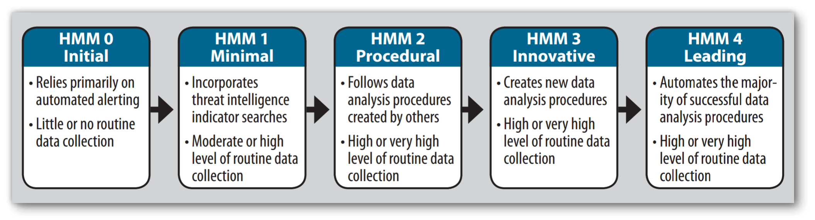
Triage
Reactive
Hunting
Proactive
David Bianco, “A Simple Hunting Maturity Model,” Enterprise Detection & Response blog, Oct. 15, 2015,
http://detect-respond.blogspot.com/2015/10/a-simple-hunting-maturity-model.html

Slide 12
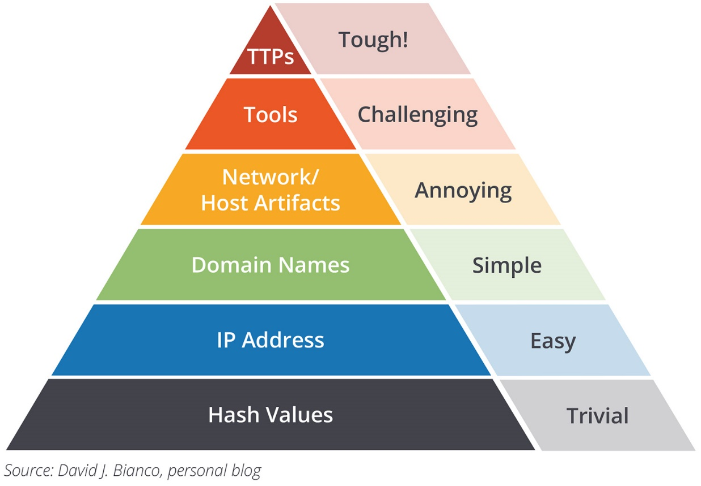

Slide 13
Tools of choice

Slide 14



Slide 15
Services and Products Leveraged
IBM X-Force Exchange
Cisco Umbrella Investigate
Risk IQ Passive Total
The Tor Project
Whois
VirusTotal
Cisco Threat Grid
Team Cymru MHR

Slide 16
File hash
Use Case One:

Slide 17
File hash
SHA256:
ed01ebfbc9eb5bbea545af4d01bf5f1071661840480439c6e5babe8e080e41aa
IBM X-Force Exchange
Cisco Threat Grid
VirusTotal
Team Cymru MHR

Slide 18
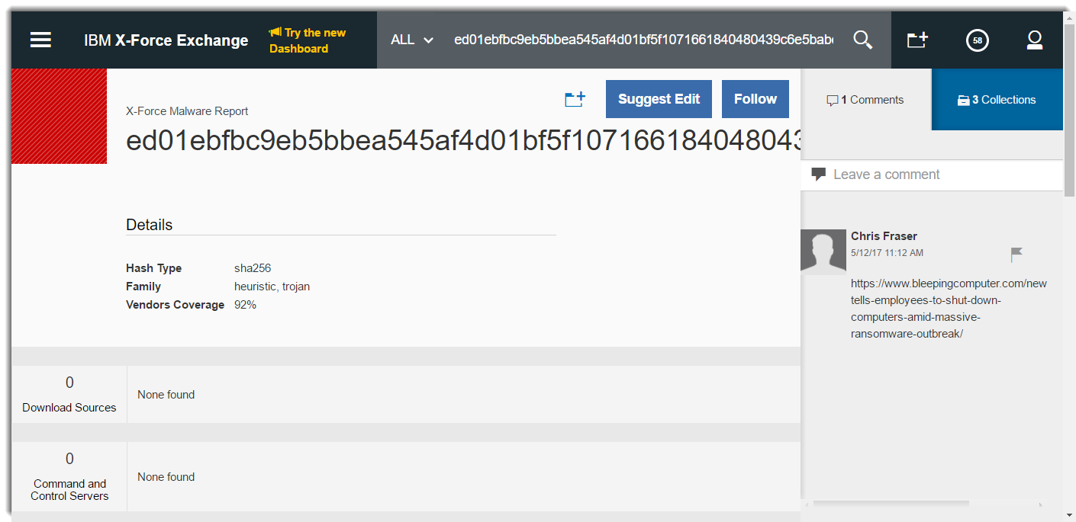
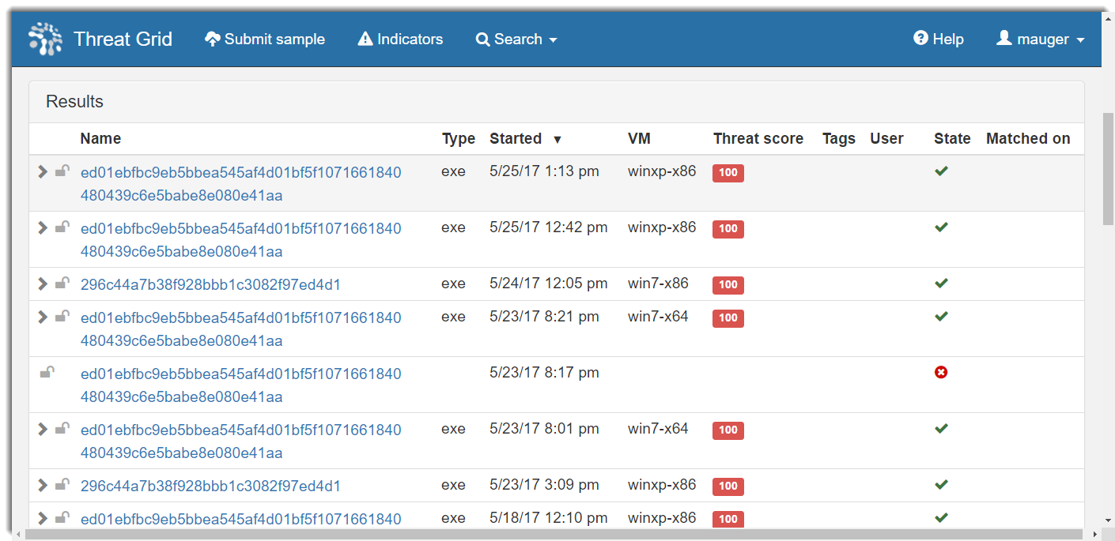
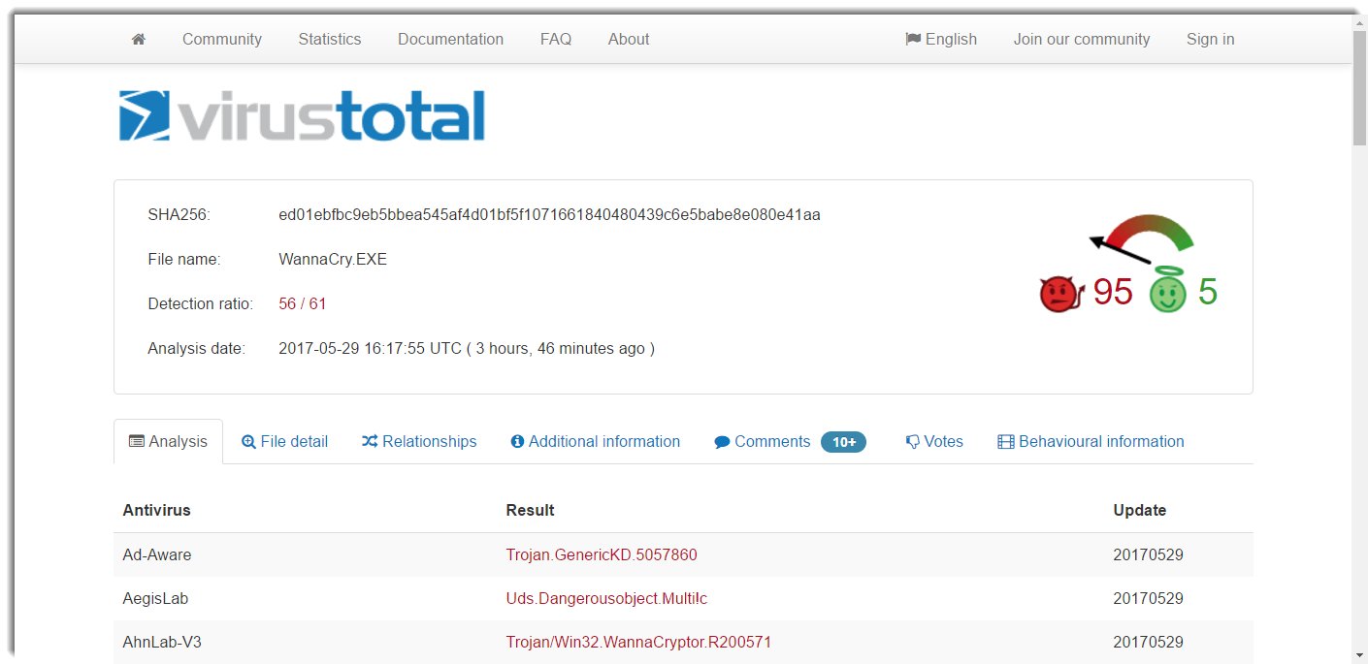

Slide 19
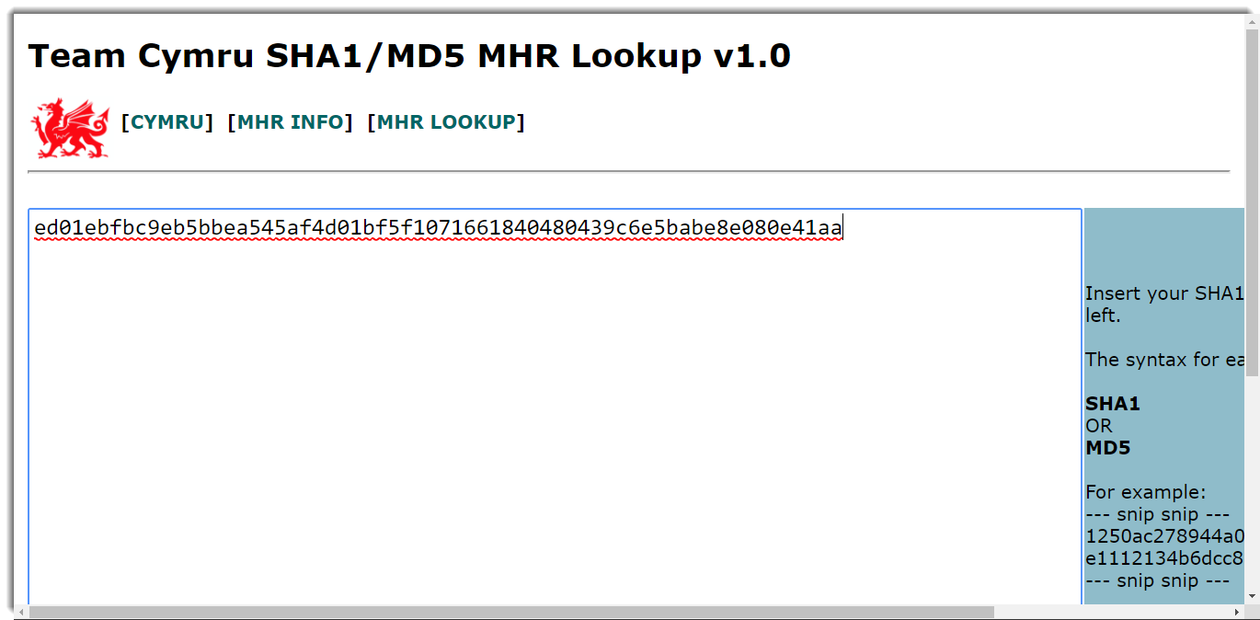


Slide 21
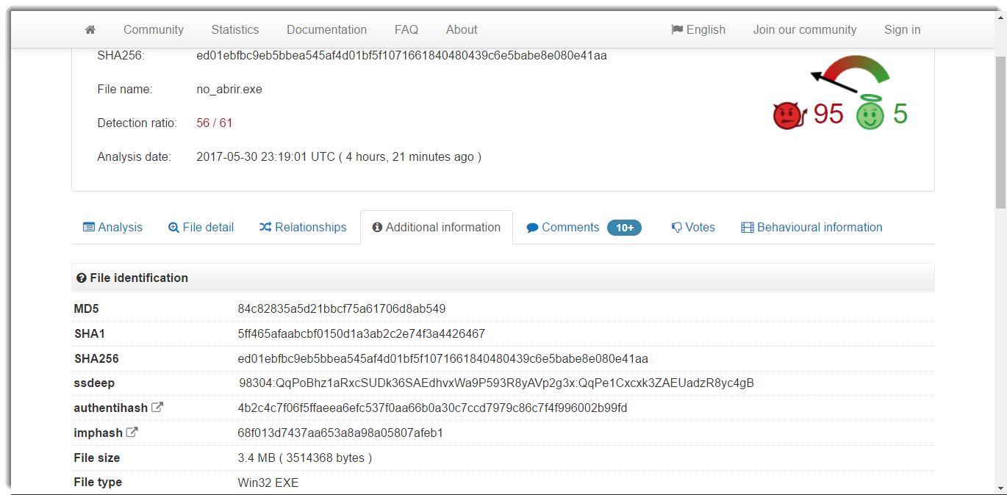

Slide 22
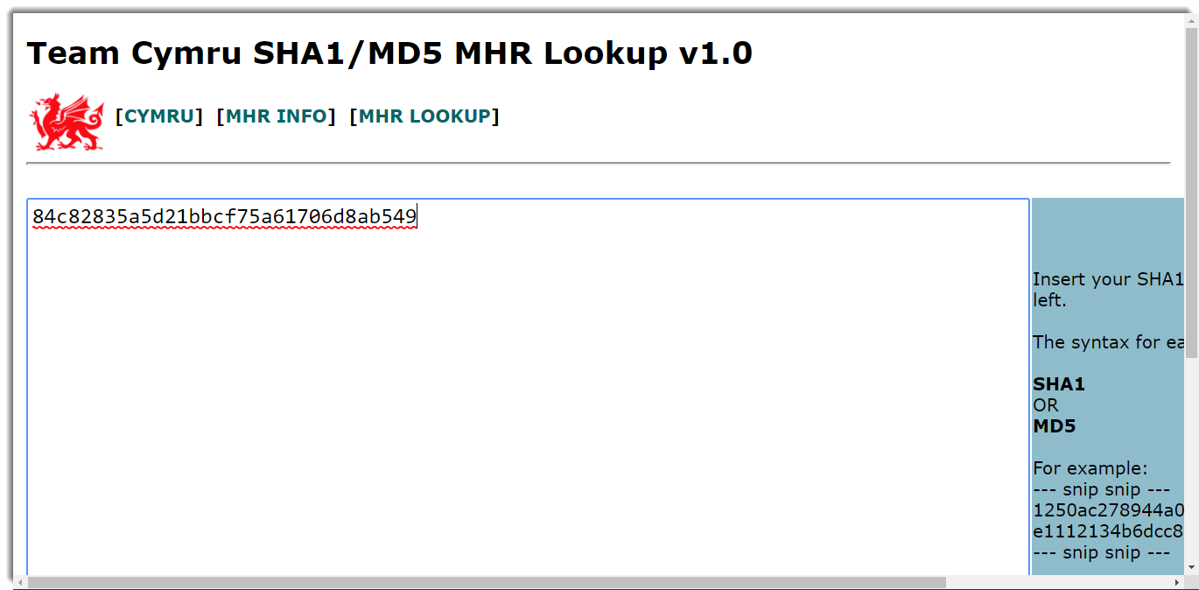

Slide 23
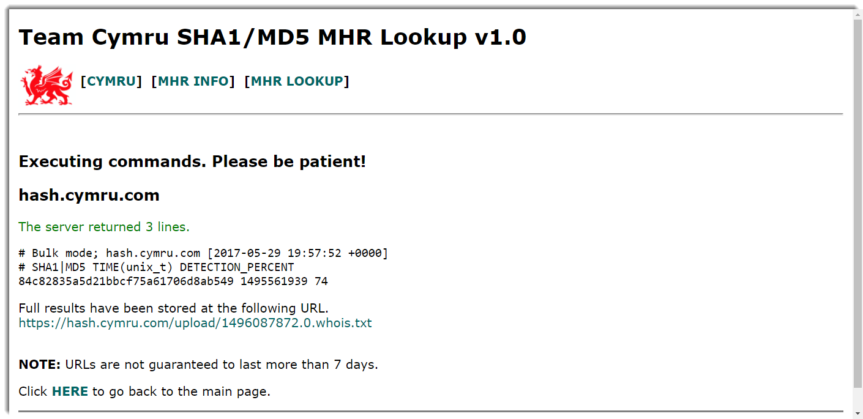


Slide 24
Simple File Hash Workflow
X-Force
If risk is high file is ‘bad’
Threat Grid
If score is 95 or greater file is ‘bad’
VirusTotal
If more than n engines convict file is ‘bad’
Save MD5
Team Cymru
Use MD5
If detection rate above 50 it’s ‘bad’

Slide 25
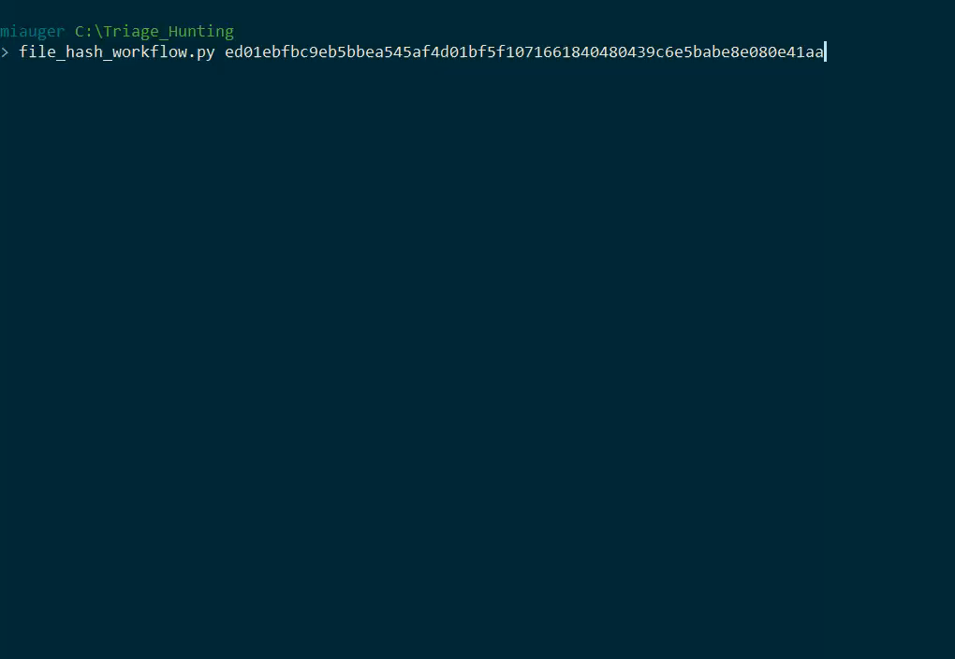

Slide 26
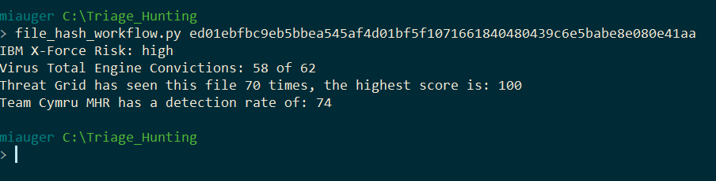

Slide 27
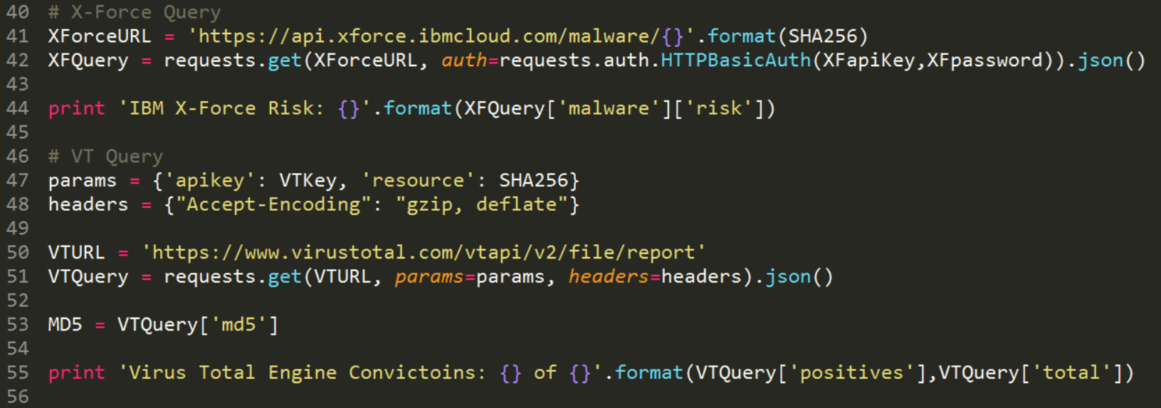

Slide 28
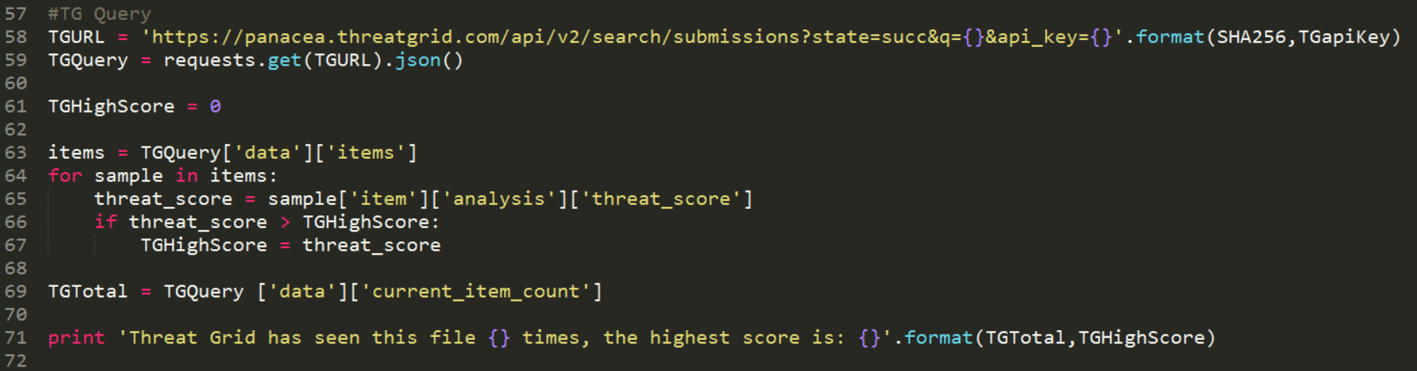

Slide 29
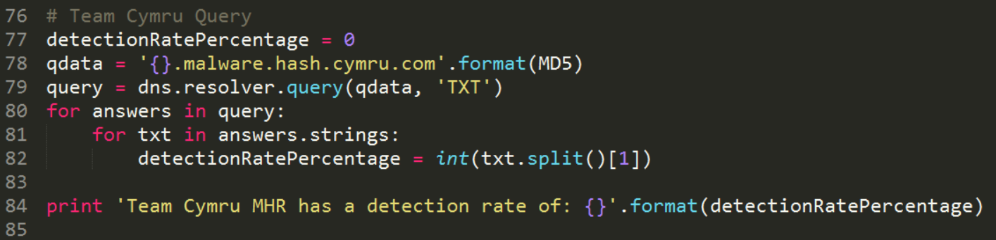

Slide 30
IP Address
Use Case Two:

Slide 31
IP Address
171.25.193.9:80
IBM X-Force Exchange
Cisco Umbrella Investigate
Risk IQ Passive Total
The Tor Project
Whois
VirusTotal
Cisco Threat Grid

Slide 32
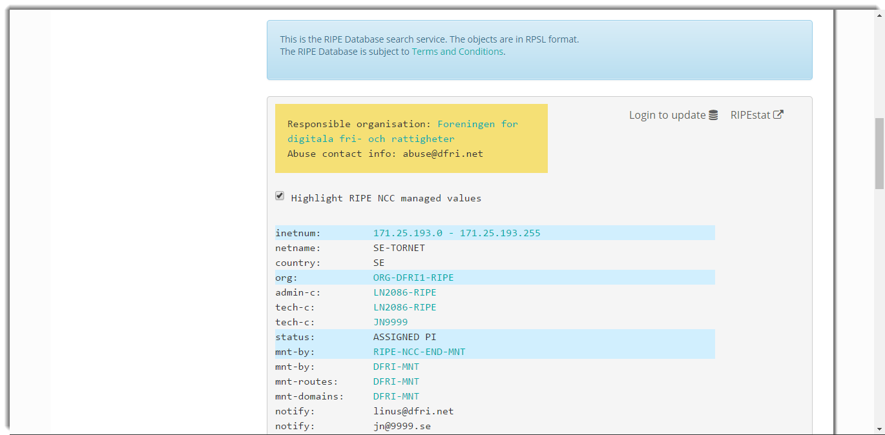
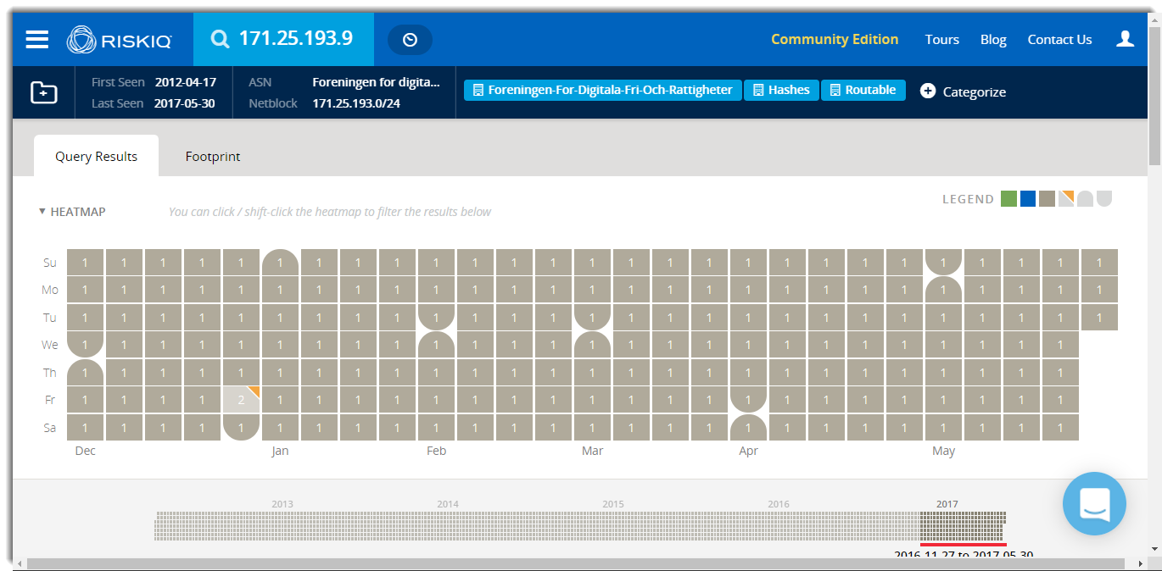
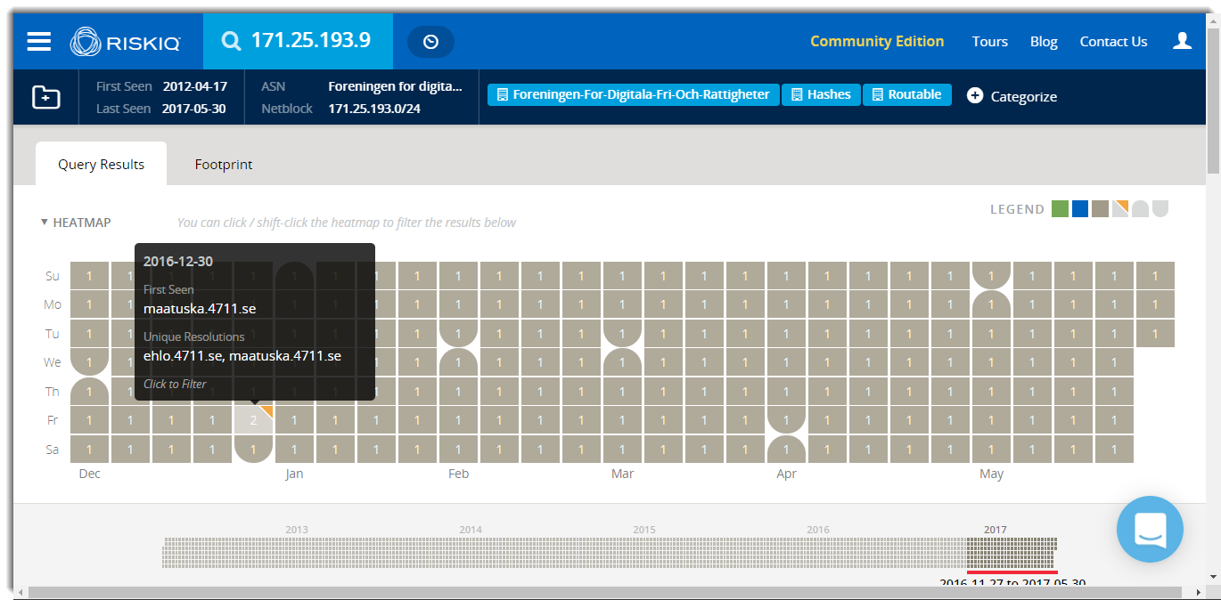
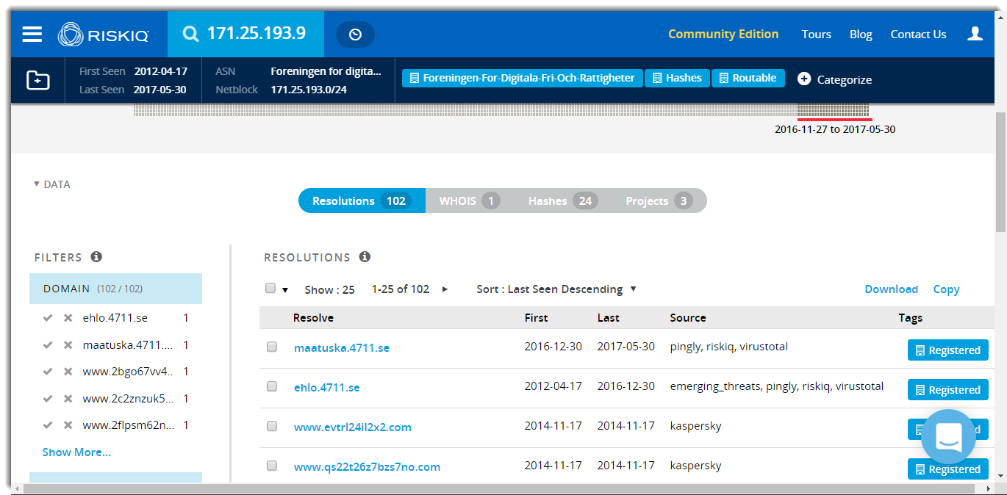
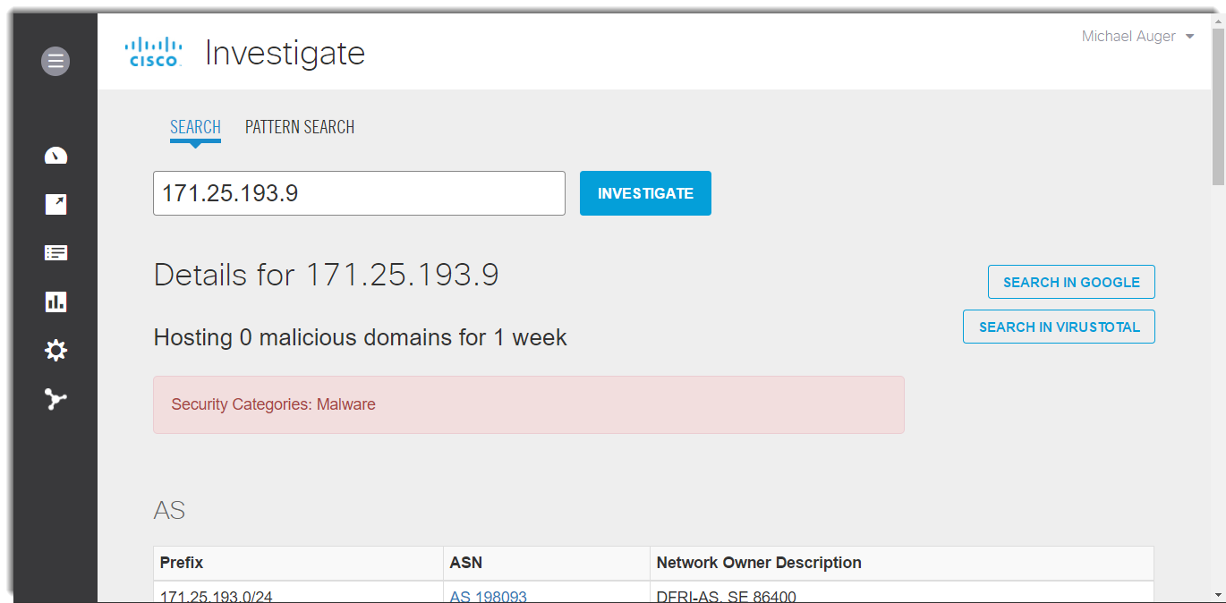
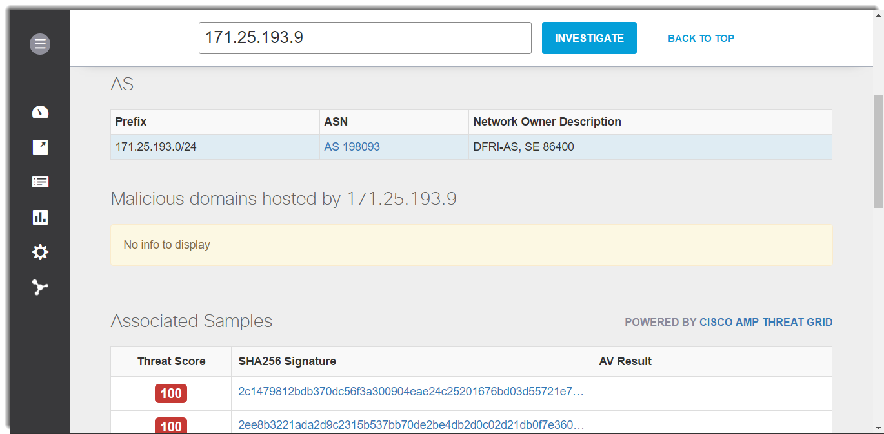
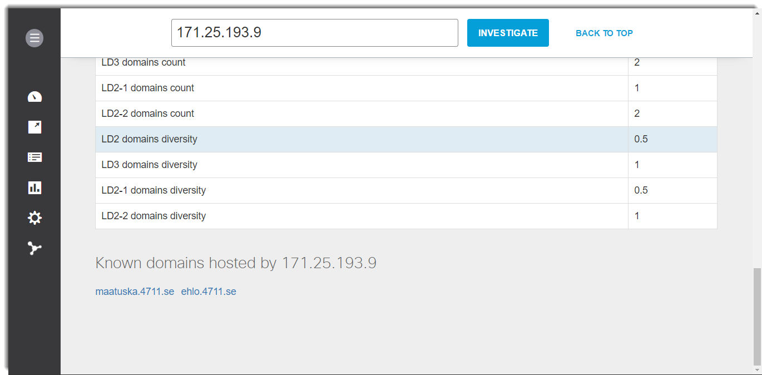
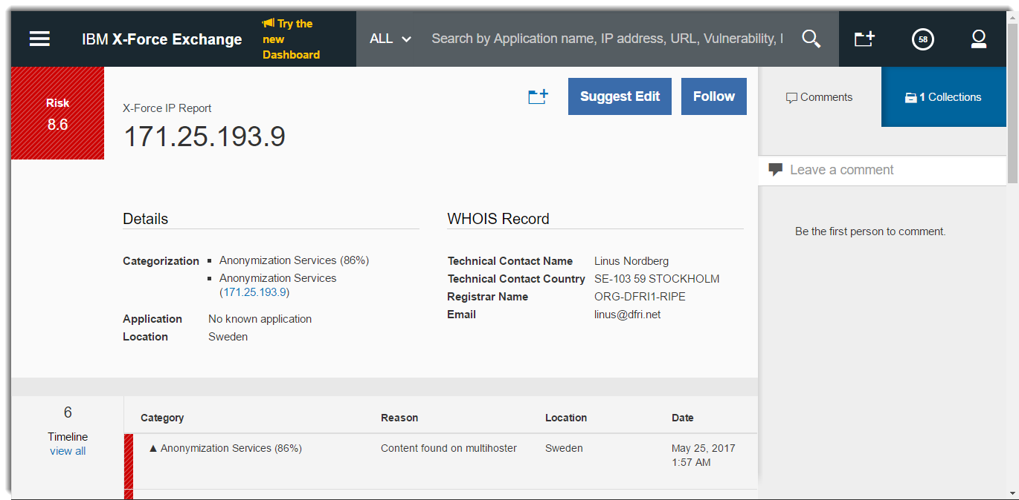

Slide 33
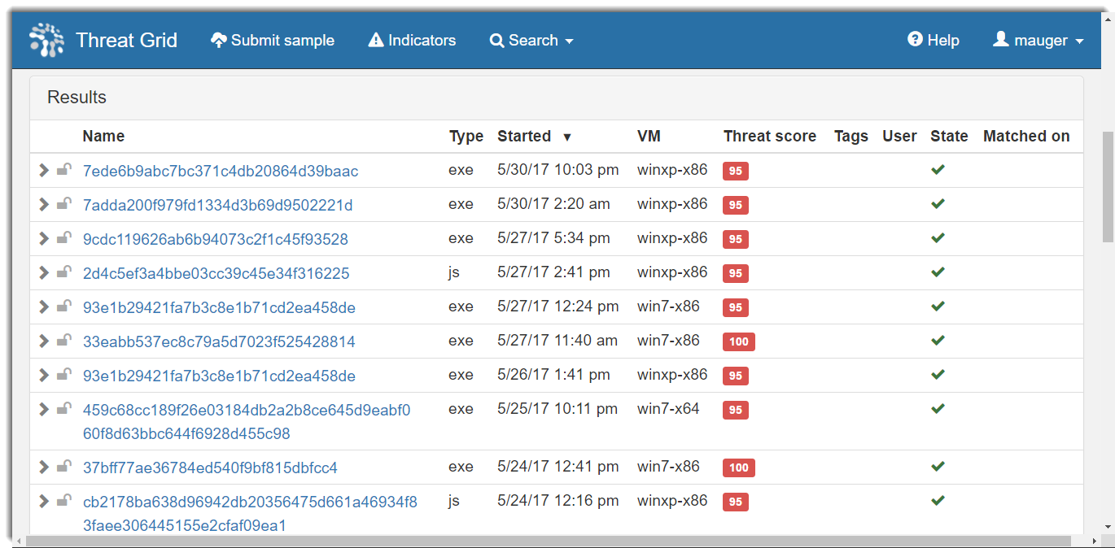
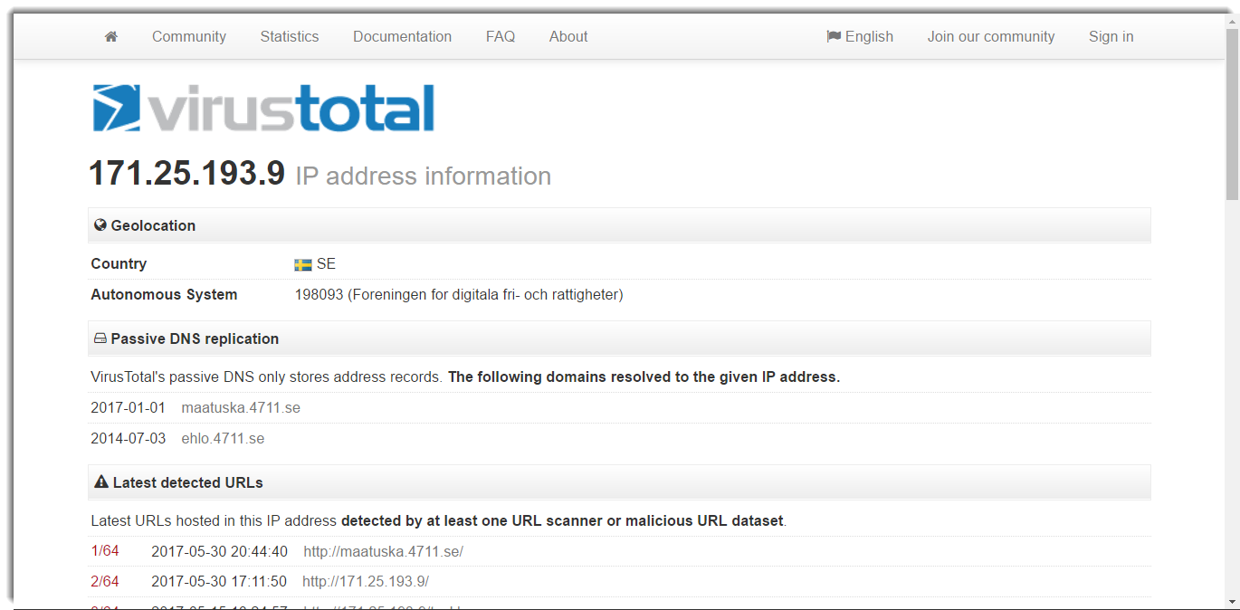
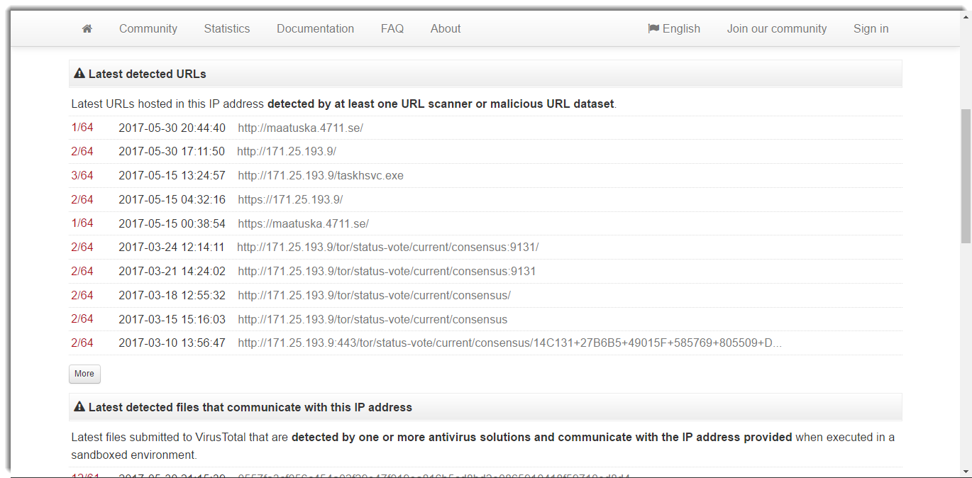
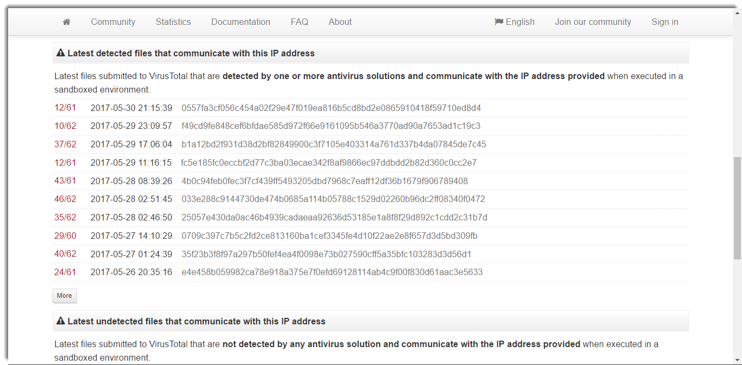
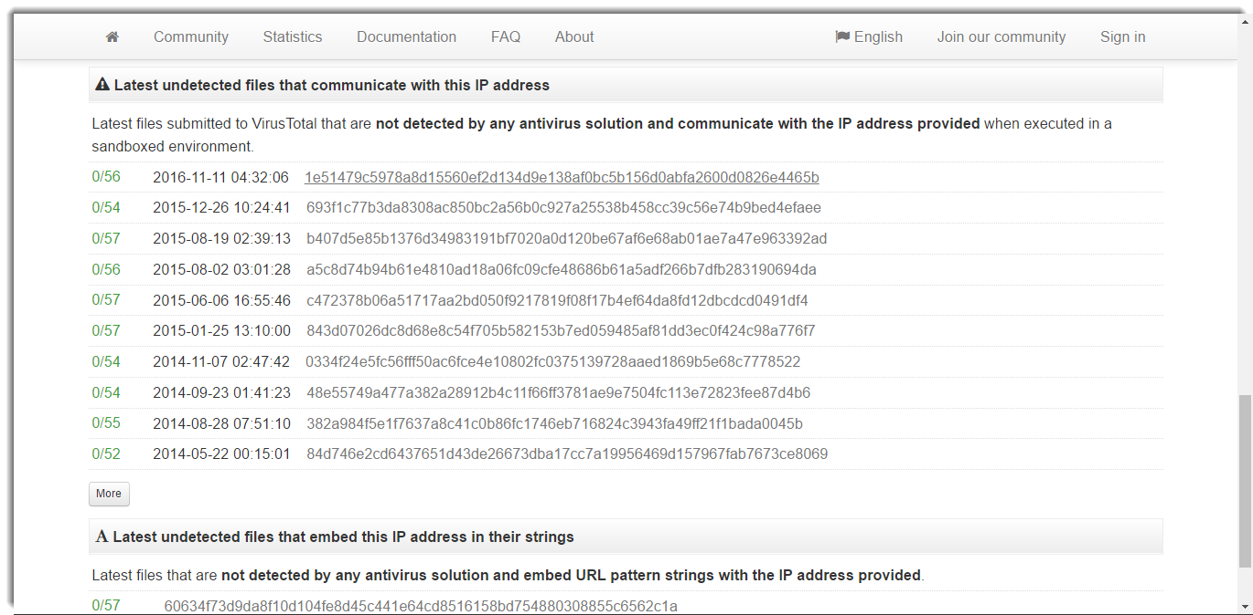

Slide 34
What do we know so far?
Swedish NGO
2 domains in recent past
1 current domain
Anonymization Services
Associated with Malware
Associated with Possibly Not Malware

Slide 35
Where to go from here?

Slide 36


Slide 37

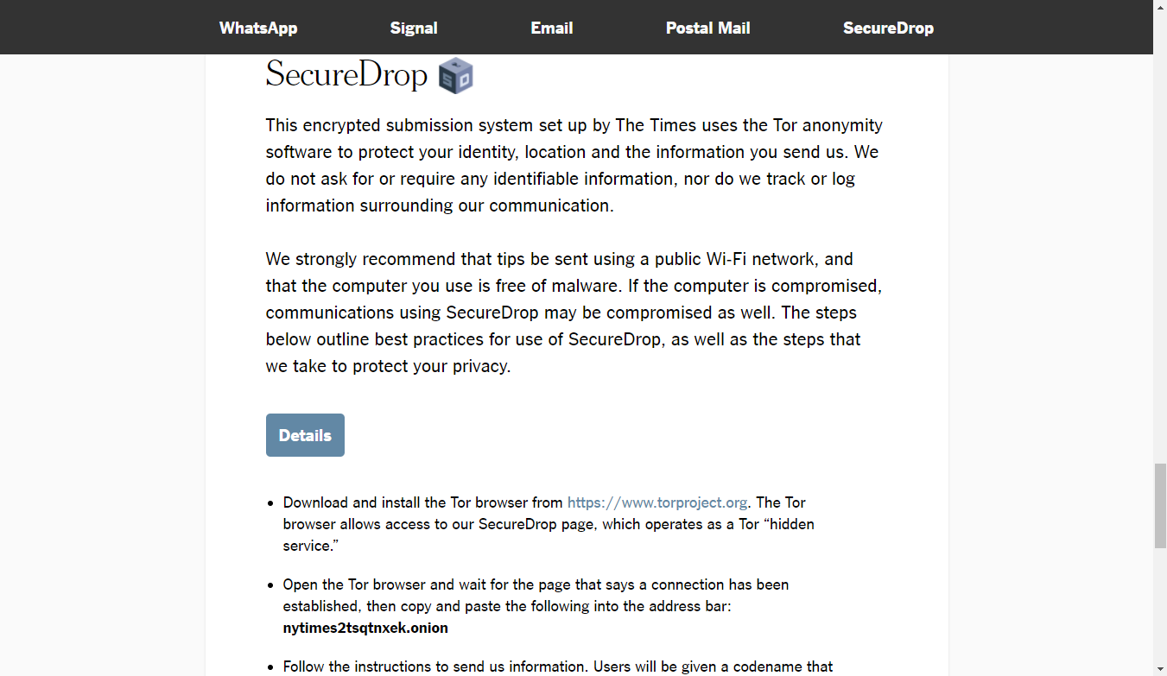
Legitimate Uses of Tor

Slide 38
Official Tor Resources
https://exonerator.torproject.org/
https://onionoo.torproject.org/
https://collector.torproject.org/
https://atlas.torproject.org/

Slide 39
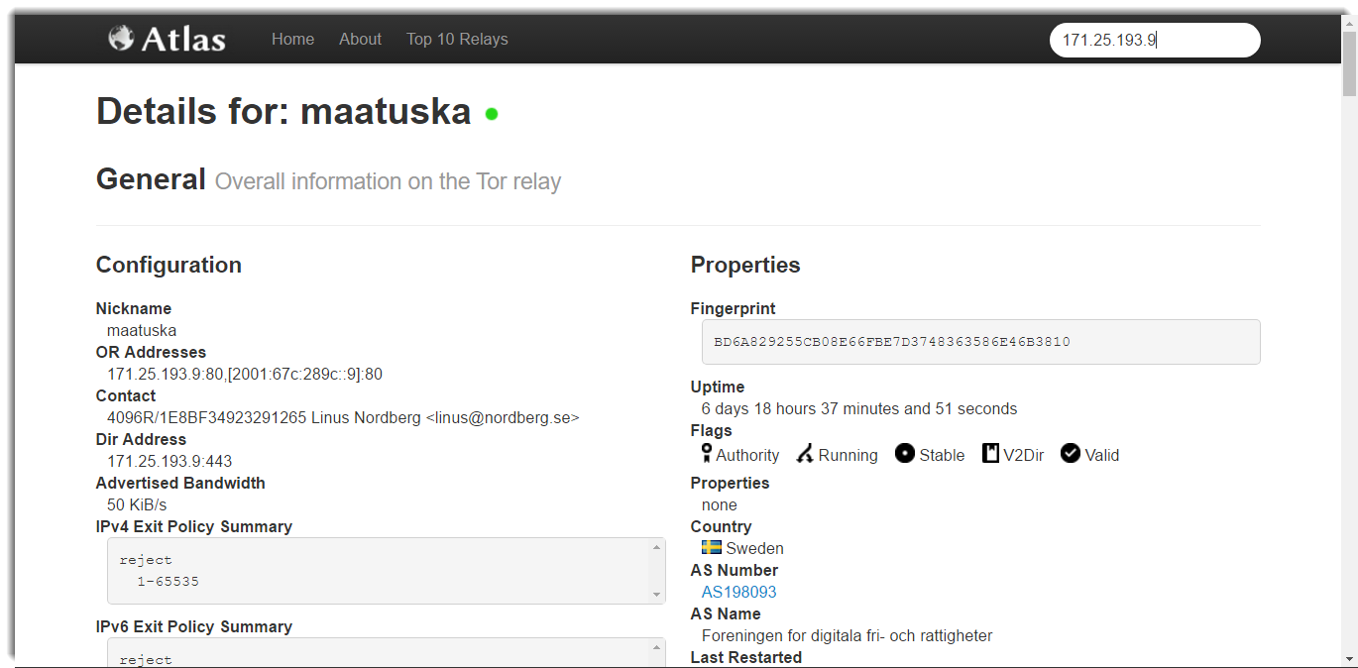

Slide 40
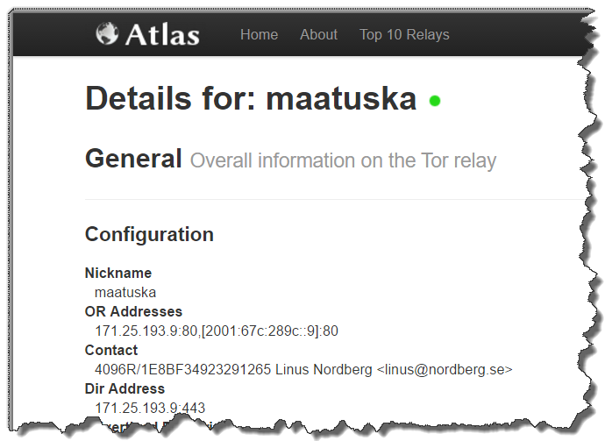

Slide 41
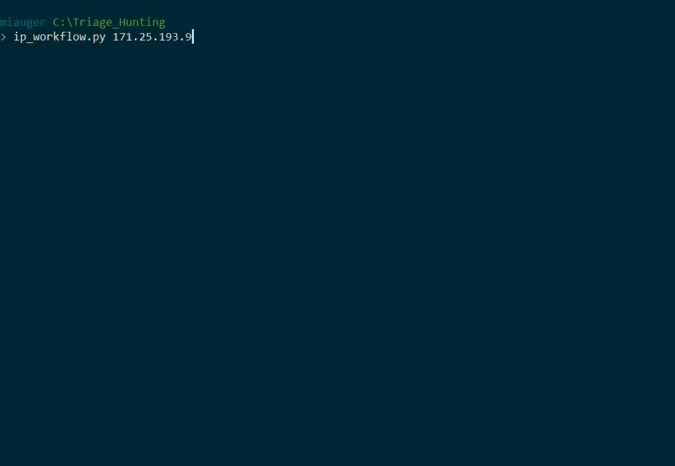

Slide 42
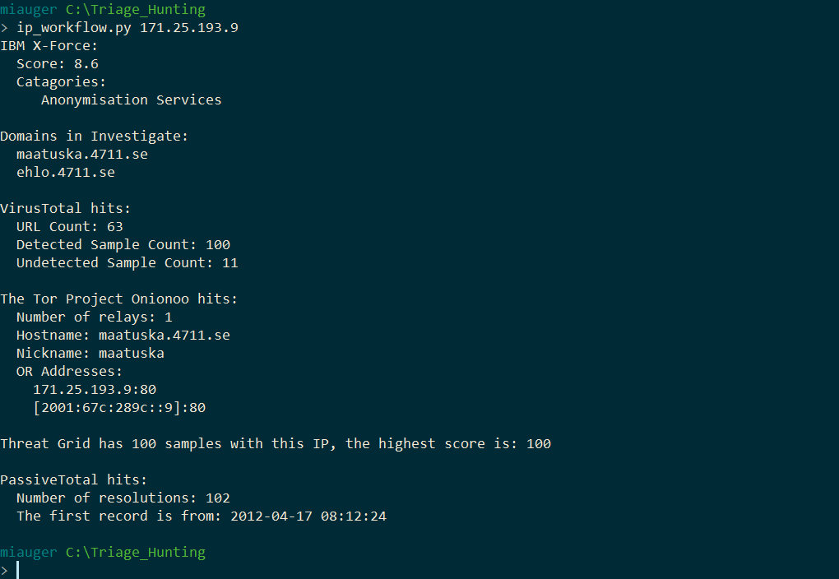

Slide 43
The trouble with ips

Slide 44
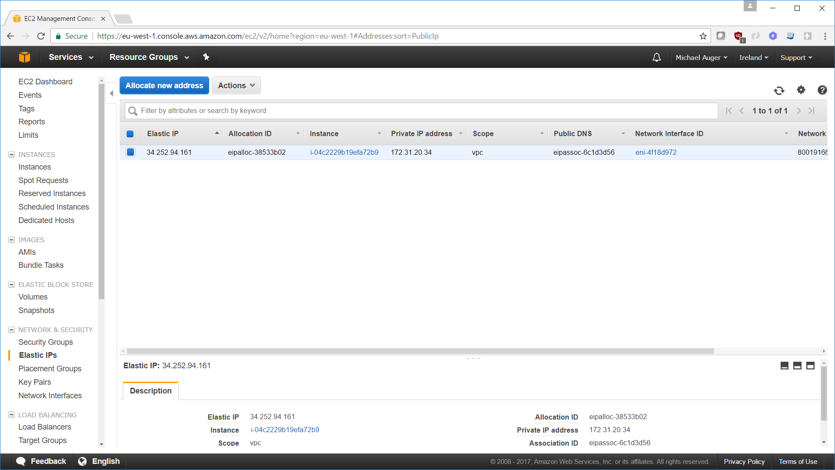

Slide 46
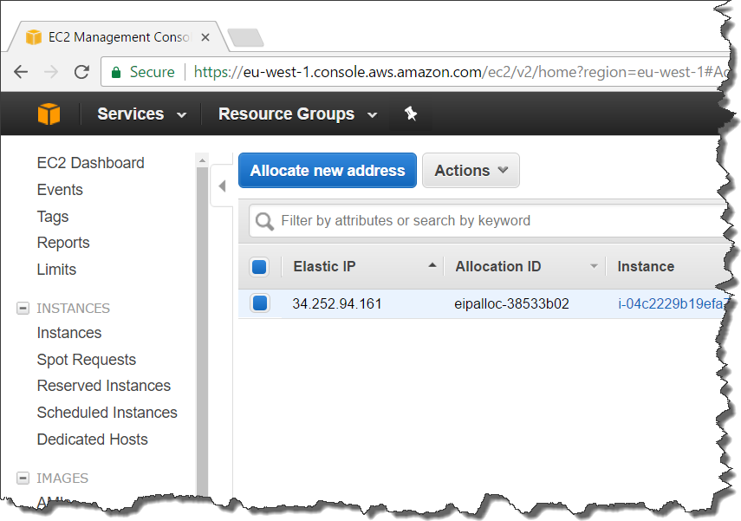

Slide 47
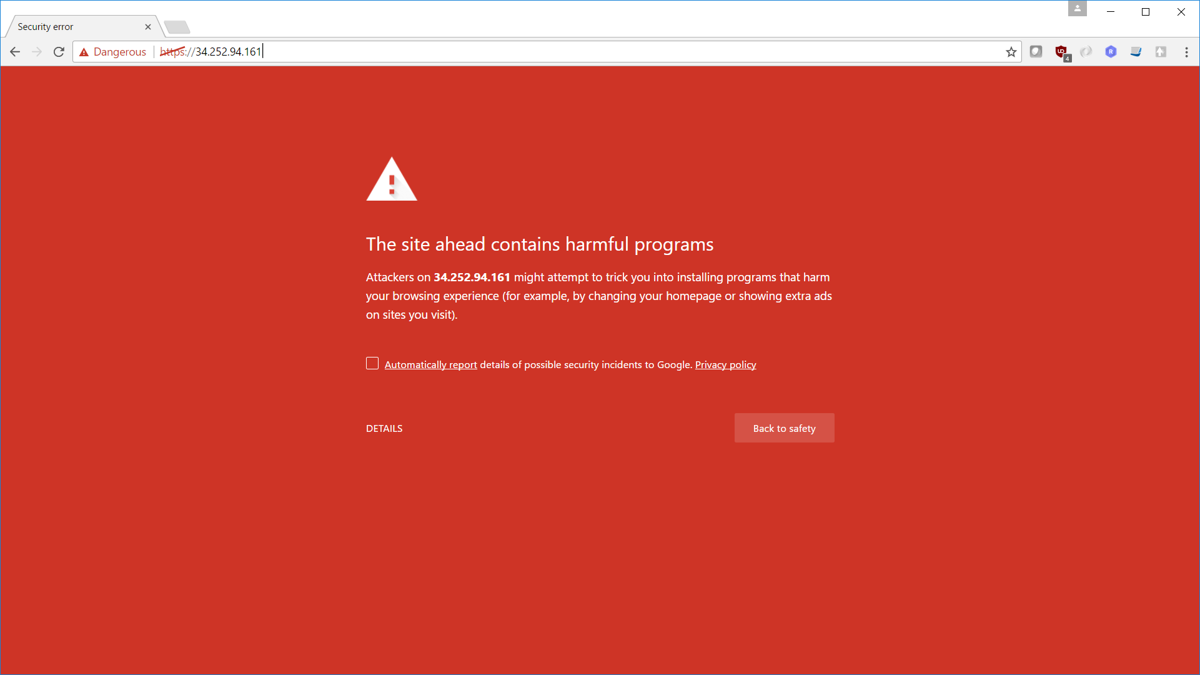

Slide 48
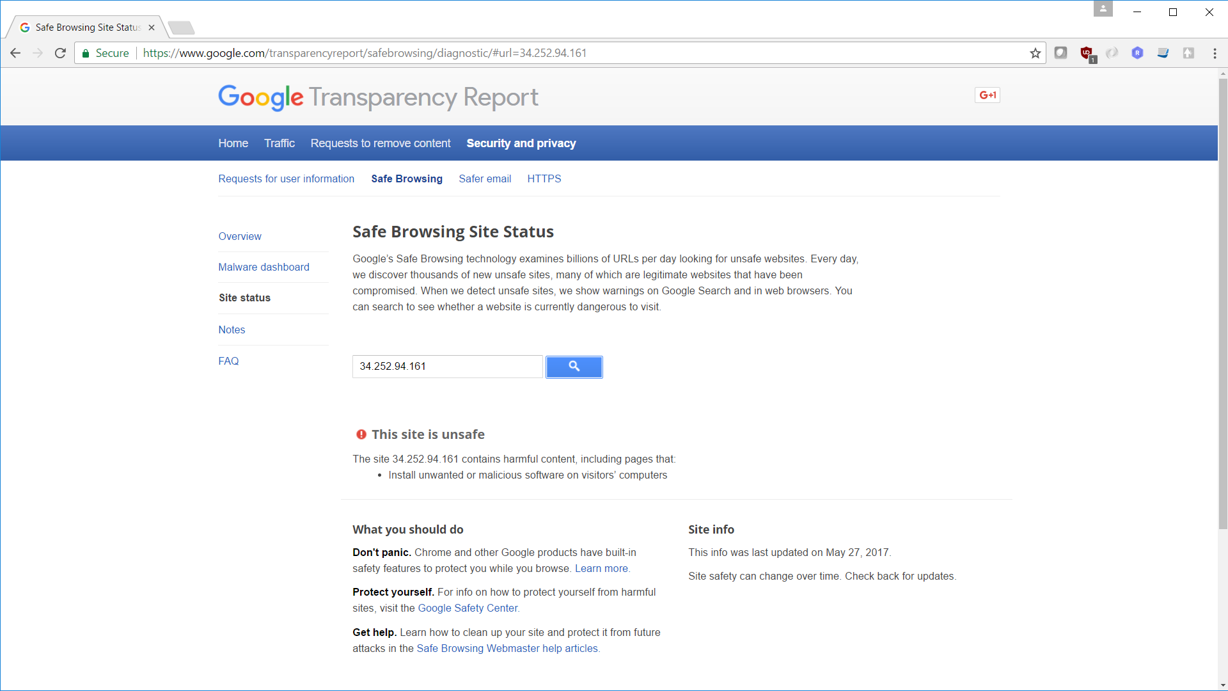

Slide 49
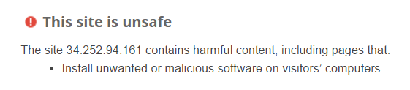

Slide 50
Domain
Use Case Three:

Slide 51
Domain
high.expbas.net
Cisco Threat Grid
IBM X-Force Exchange
Cisco Umbrella Investigate
Risk IQ Passive Total

Slide 52
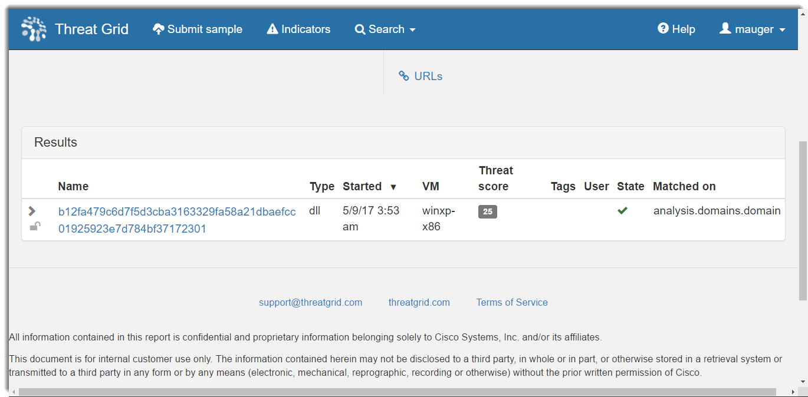
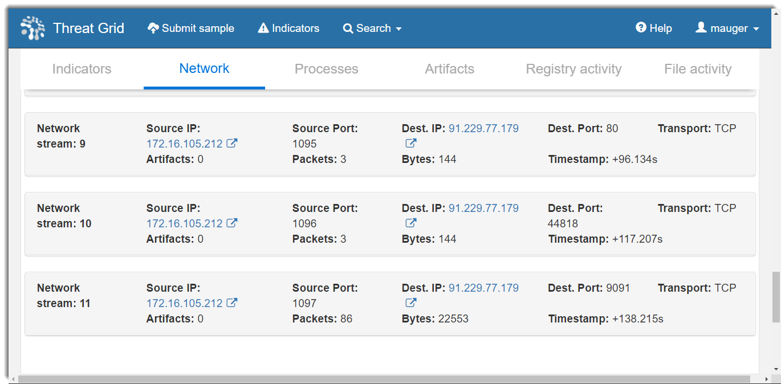
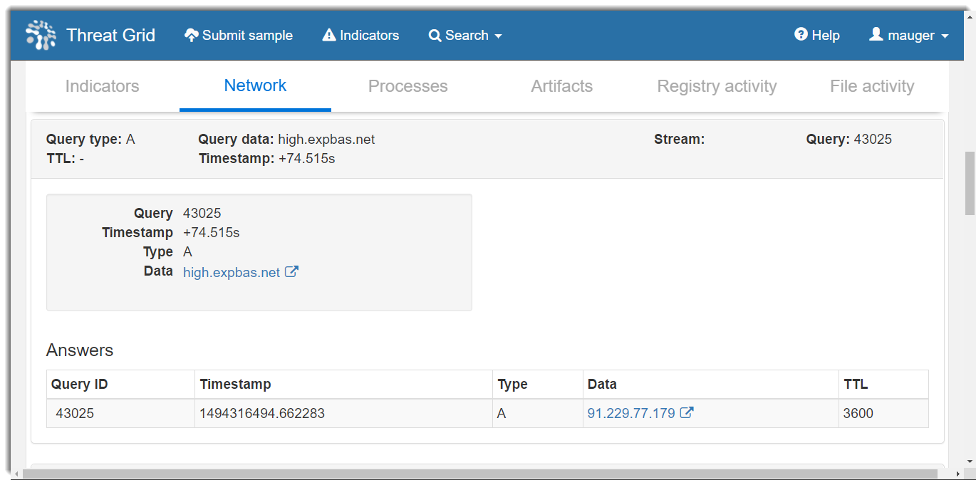
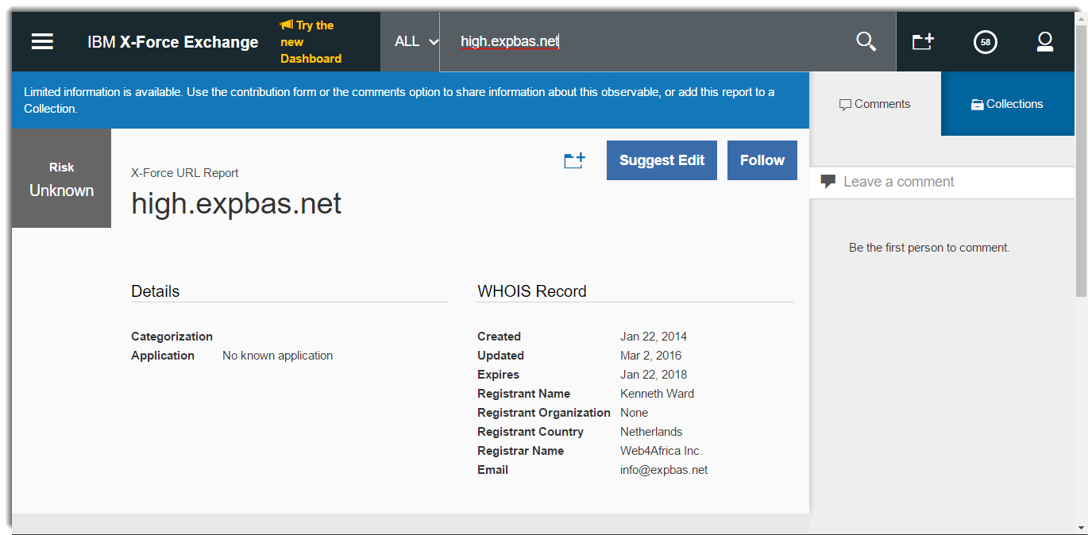
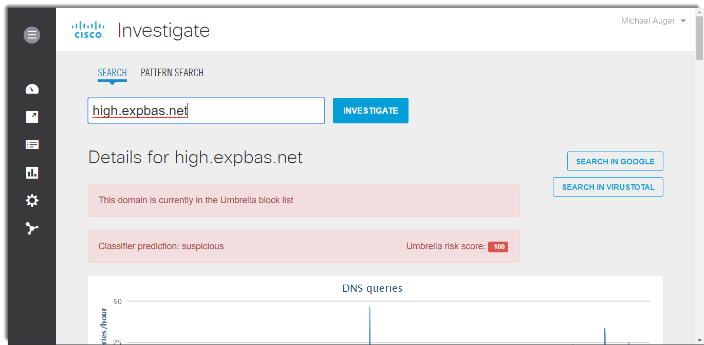
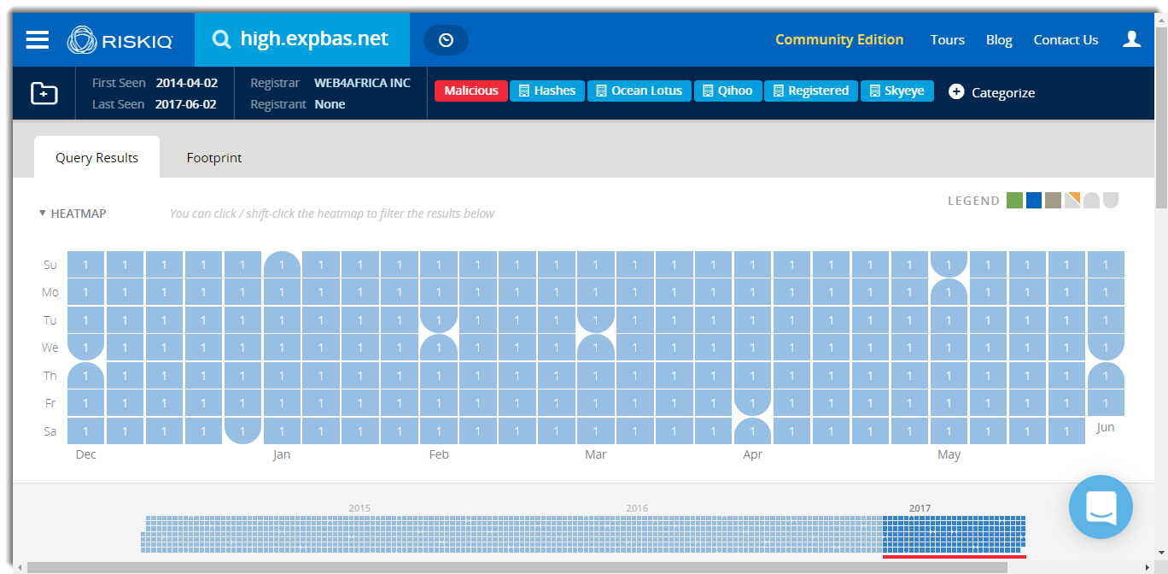
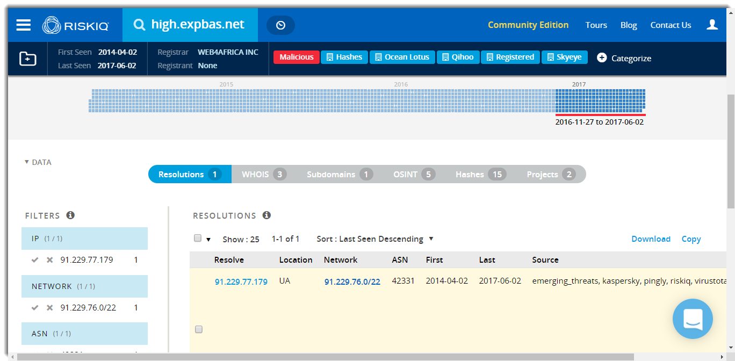

Slide 53
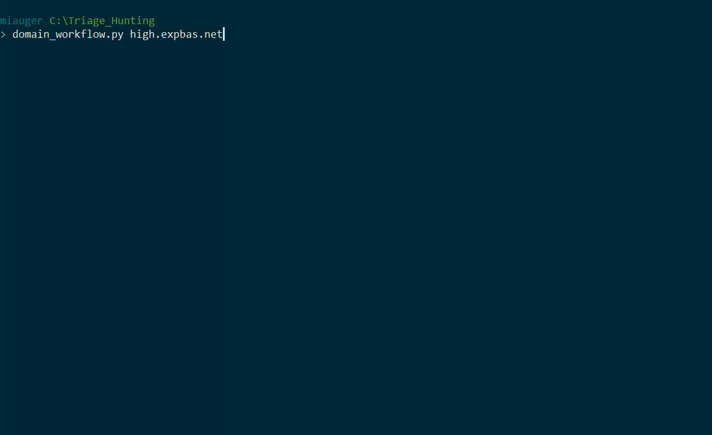

Slide 54
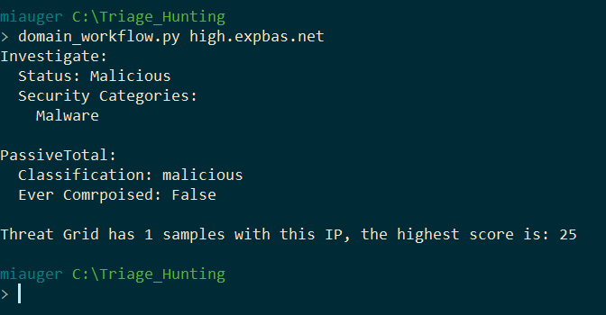

Slide 55
Domain Gotchya’s
CDNs (Akamai, MaxCDN, Facebook)
Ad Networks (Adsterra, Infolinks AppNexus)
Dynamic DNS (Dyn, NoIP, afraid.org)

Slide 56
Network / host artifacts.
Use Case Four:

Slide 57
Network / Host Indicator
mbfce24rgn65bx3g.2kzm0f.com
Risk IQ Passive Total
Cisco Threat Grid

Slide 58
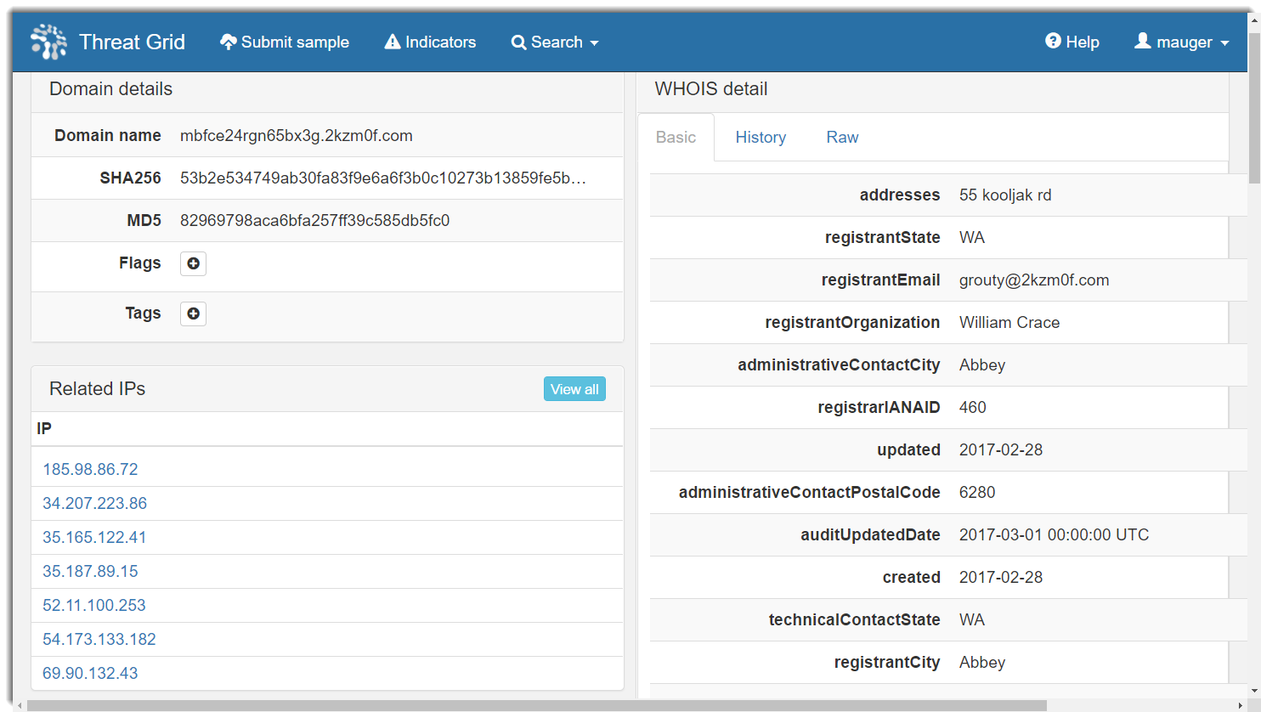
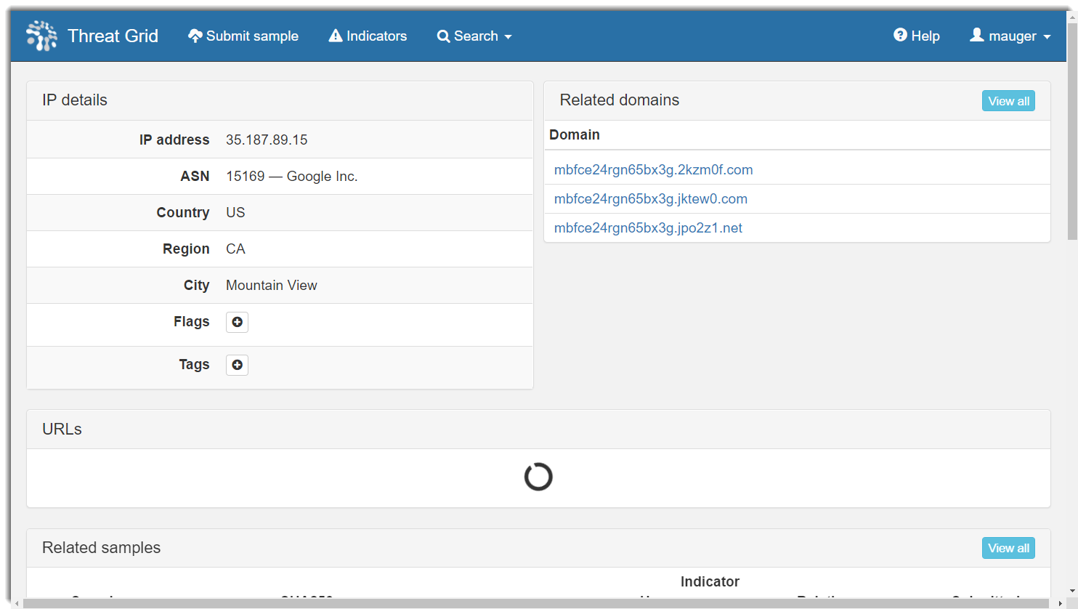
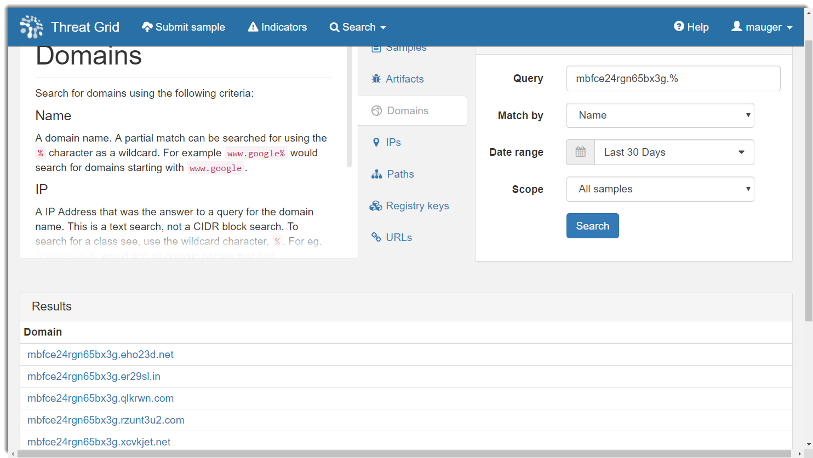

Slide 59
22 Top Level Domains
30 IP Addresses
3io74zx.com
2kzm0f.com
l3nq0.net
jktew0.com
jpo2z1.net
er29sl.com
rzunt3u2.com
6t4u2p.net
9dpnlu2.com
eho23d.net
io23zc.com
k5hjej9.com
lfsjkad.net
op7su2.com
p0alj2.com
pbt2ac.com
pe6zawc.com
qlkrwn.com
we0sgd.com
xcvkjet.net
y8lkjg5.net
yio3lvx.com
185.98.86.72
34.207.223.86
35.165.122.41
35.187.89.15
52.11.100.253
54.173.133.182
69.90.132.43
185.98.86.139
54.161.109.227
35.164.244.192
54.191.122.32
52.90.78.180
91.214.114.197
91.214.114.5
35.166.202.132
185.17.121.6
46.173.219.33
47.91.110.245
47.91.127.246
35.167.221.128
54.149.186.25
54.175.146.166
54.211.245.199
192.42.116.41
54.146.39.22
66.23.246.239
46.183.166.102
54.161.154.9
185.180.231.138
47.88.175.7
2 Sub Domains
7gie6ffnkrjykggd
mbfce24rgn65bx3g

Slide 60
Pivoting IOC types
Use Case Four point Five:

Slide 61
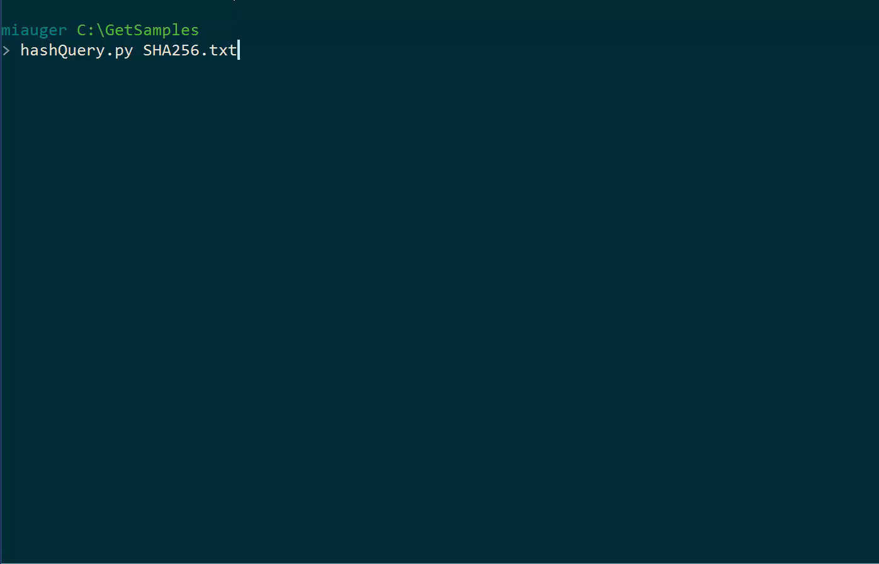

Slide 62


Slide 63
Python to know

Slide 64
Basic Python Requirements
requests (for making http requests easily)
if statements (for building simple logic)
for loops (for parsing JSON data)
while loops (for more recursive queries)
file operators (to write the output to a file)

Slide 65
The hardest part is authentication
API Paramter
Basic Auth
Header Token
JSON Parameter

Slide 66
Vendors in the space

Slide 67








Slide 68
Q and A

